Slide 1
Conflict

Slide 2
Definition of Conflict
Definition of Conflict
A process that begins when one party perceives that another party has negatively affected, or is about to negatively affect, something that the first party cares about.
1

Slide 3
Views of Conflict
Is conflict always harmful?
How can we prevent harmful effect of conflict?
1

Slide 4
Views of Conflict
Traditional View of Conflict
Conflicts are bad and should be avoided.
Conflict is dysfunctional outcome resulting from
Solution

Slide 5
Views of Conflict
Traditional View of Conflict
Problem with this view?

Slide 6
Views of Conflict
Interactionist View of Conflict
Minimal level of conflict can help
Why?
Two different types of conflict
Functional conflict:
Dysfunctional (destructive) conflict:

Slide 7
Views of Conflict
Task conflict:
Relationship conflict:
Process conflict:
1

Slide 8
Views of Conflict
Task and process Conflict can be functional when …..

Slide 9
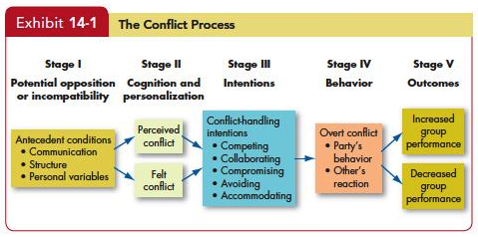
Conflict Process
1

Slide 10
Conflict Process
Stage 1: Potential opposition or incompatibility
Communication
Structure
Personal Variable

Slide 11
Conflict Process
Stage 2: Cognition and Personalization
Perceived conflict
Felt conflict
Conflict issue is defined as win-win or zero-sum

Slide 12
Conflict Process
Stage 3: Intentions
Decisions to act in a certain way

Slide 13
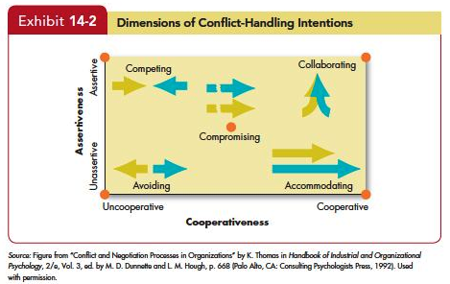
Conflict Process
1

Slide 14
Conflict Process
Stage 4: Behavior
Dynamic process of interaction
E.g., arguing, threatening, etc.

Slide 15
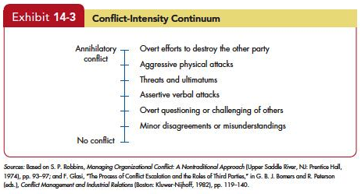
Conflict Process
1

Slide 16
Conflict Process
Stage 4: Behavior
Dynamic process of interaction
E.g., arguing, threatening, etc.
Conflict Management
De-escalate or encourage conflict by behavioral techniques

Slide 17
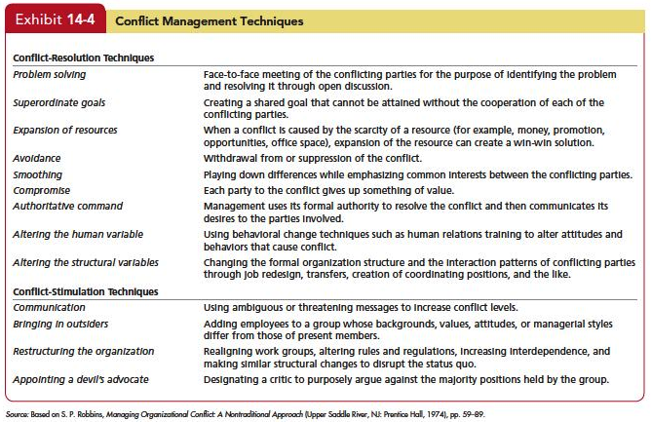
1

Slide 18
1

Slide 19
Conflict Process
Stage 5: Outcomes
Functional outcomes
Dysfunctional outcomes

Slide 20
Managing functional conflicts as a manager
Recognizing disagreement
Open discussion
Emphasize shared interests

